Slide 1
Hobbies and Interests

Slide 2
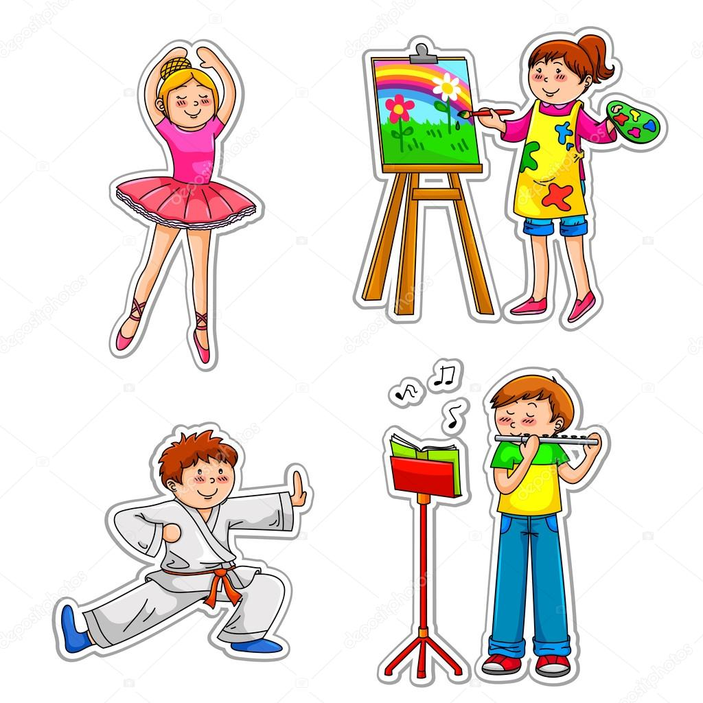
-ing
[ɪŋ]

Slide 3
“A Journalist”

Slide 4
Learning
things
Making
things
Doing
things
Collecting
things

Slide 5
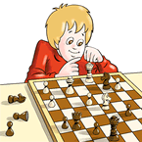
Look at the picture and choose the correct option
His hobby is….
Playing chess
Great Job!
Reading books.
Try Again

Slide 6
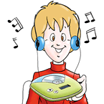
Look at the picture and choose the correct option
His hobby is….
Listening to music
Great Job!
Playing football
Try Again

Slide 7
Look at the picture and choose the correct option
His hobby is….
Watching TV.
Try Again
Reading books
Great Job!

Slide 8
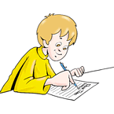
Look at the picture and choose the correct option
His hobby is….
Writing letter
Great Job!
Painting.
Try Again

Slide 9
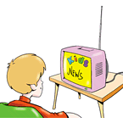
Look at the picture and choose the correct option
His hobby is….
Reading books.
Try Again
Watching TV
Great Job!

Slide 10
Look at the picture and choose the correct option
His hobby is….
Collecting coins
Great Job!
Playing football.
Try Again

Slide 11
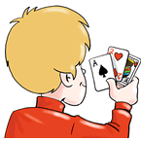
Look at the picture and choose the correct option
His hobby is….
Playing cards
Great Job!
Playing guitar
Try Again

Slide 12
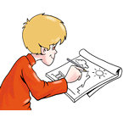
Look at the picture and choose the correct option
His hobby is….
Reading books.
Try Again
Drawing
Great Job!

Slide 13
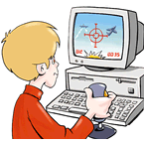
Look at the picture and choose the correct option
His hobby is….
Playing computer games
Great Job!
Watching TV..
Try Again

Slide 14
Monday do karaoke
Tuesday listen to jazz music
Wednesday play the guitar
Thursday stay in bed
Friday go to a rock concert
Weekends go for a drive

Slide 16
What hobby is this?
A library, books, magazines, comics.
A park, long distances, a trainer, water.
Many friends, e-mails, Skype, the world.

Slide 18
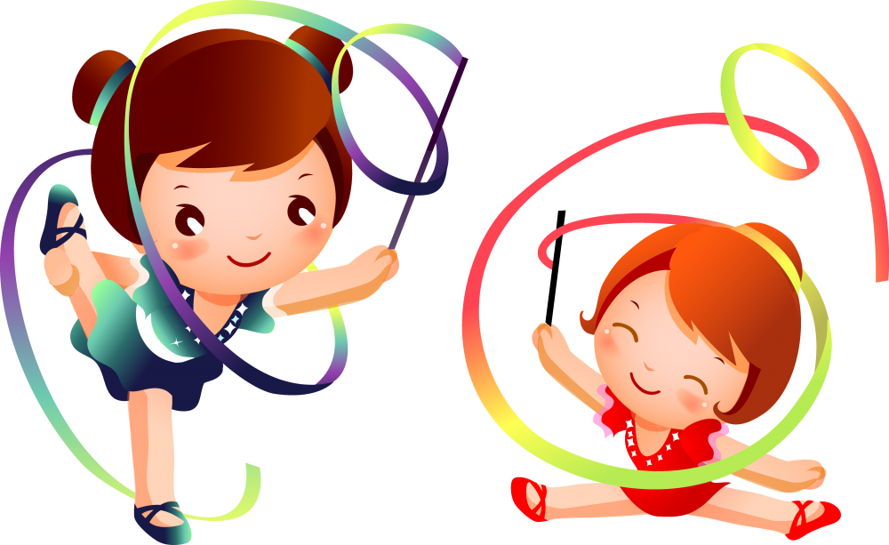

Slide 20
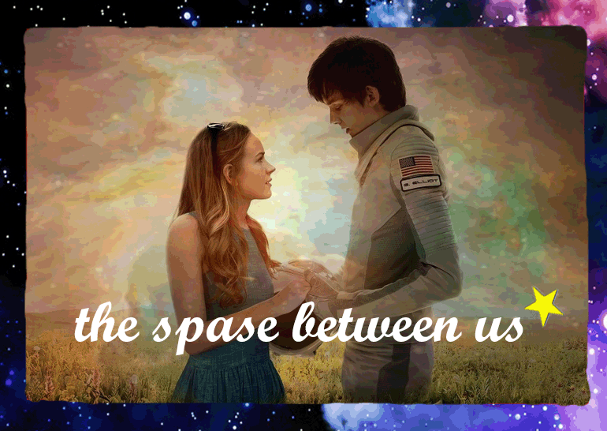
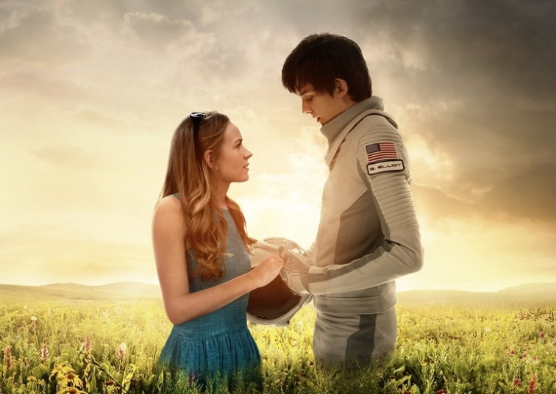

Slide 21
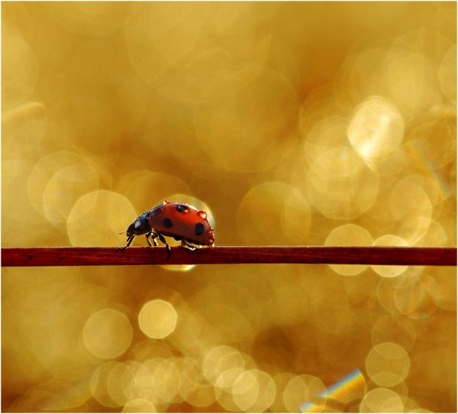

Slide 23
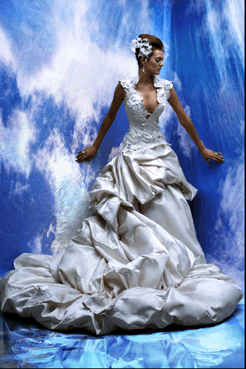

Slide 24
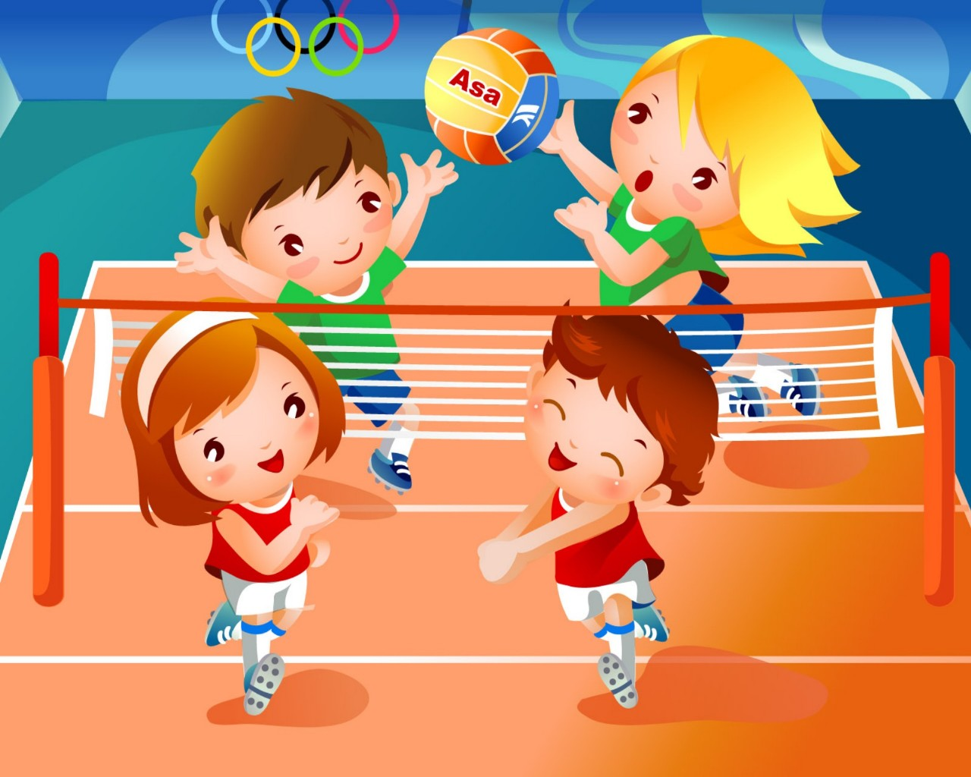

Slide 28
Cinquain
Hobbies
______
______
______
______

